Slide 1
Branching-Time Active Inference
Luca Annese
18805A

Slide 2
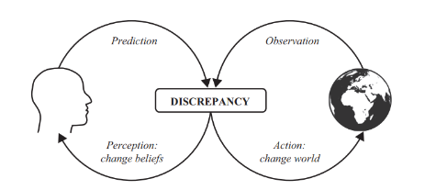
Active Inference
“Both perception and action serve the very same objective. As a first approximation, this common objective of perception and action can be formulated as a minimization of the discrepancy between the model and the world. Sometimes this is operationalized in terms of prediction error.”
Notes:
This framework treats perception, learning and action as INDEPENDENT form of INFERENCE, is active in the sense that the agent actively engage with the environment
+

Slide 3
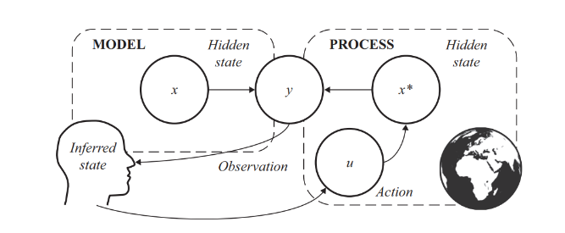
Inference

Slide 4
Inference – Model Inversion
s
o
infere
causes
o

Slide 5

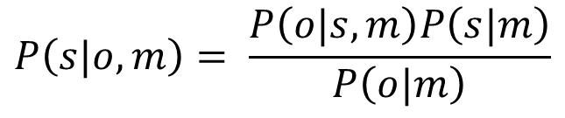


Inference – Bayes’ Theorem
Bayes’ Rule:
Computing the Posterior distributionis known as the inference problem.
Observations
$$P\left(o | s, m\right) Likelihood mapping$$
$$P\left(s|o,m\right)= \frac{P\left(o|s,m\right)P\left(s|m\right)}{P\left(o|m\right)}$$
$$P\left(s | m\right) Prior distribution$$
$$P\left(o | m\right) Model evidence$$
Hidden states
$$P\left(s | o, m\right) Posterior distribution$$

Slide 6

Inference – Bayes’ Theorem
Bayes’ Rule:
Computing the Posterior distributionis known as the inference problem.
But:
$$P\left(o | m\right)=\int{P\left(s,o\right) ds}$$
Observations
$$P\left(o | s, m\right) Likelihood mapping$$
$$P\left(s|o,m\right)= \frac{P\left(o|s,m\right)P\left(s|m\right)}{P\left(o|m\right)}$$
$$P\left(s | m\right) Prior distribution$$
$$P\left(o | m\right) Model evidence$$
Hidden states
$$P\left(s | o, m\right) Posterior distribution$$

Slide 7
Inference - Evidence
Bayes’ Rule:
Computing the Posterior distributionis known as the inference problem.
But:
$$P\left(o | m\right)=\int{P\left(s,o\right) ds}$$
Observations
$$P\left(o | s, m\right) Likelihood mapping$$
$$P\left(s|o,m\right)= \frac{P\left(o|s,m\right)P\left(s|m\right)}{P\left(o|m\right)}$$
$$P\left(s | m\right) Prior distribution$$
$$P\left(o | m\right) Model evidence$$
Hidden states
$$P\left(s | o, m\right) Posterior distribution$$
Intractable

Slide 8

Variational Inference – Bounding evidence
$$Q\left(s\right)=\prod_{i}{Q(s_{i})}$$
Consider the approximate posterior distribution:
Notes:
The problem of ciputing evidence is tackled with VARIOTIONAL FRAMEWORK, in which we introduce two important quantities: the APPROX POSTERIORnad

Slide 9
Variational Inference – Bounding evidence
$$Q\left(s\right)=\prod_{i}{Q(s_{i})}$$
Consider the approximate posterior distribution:
Mean-Field approximation

Slide 10
Variational Inference – Bounding evidence
$$Q\left(s\right)=\prod_{i}{Q(s_{i})}$$
$$Q\left(s\right)=\prod_{i}{Q(s_{i})}$$
Consider the approximate posterior distribution:
Rewriting the negative log evidence (surprise), we extract the VFE formulation:
Mean-Field approximation
Notes:
SURPRISE => how much the observations the agent receives are surprising for the mdoel, so a low surprise means that the model is good enough and no new observation is unexpected, therefore the model is a good approximation of the real process
We extract the VFE as the UPPER BOUND of surprise

Slide 11
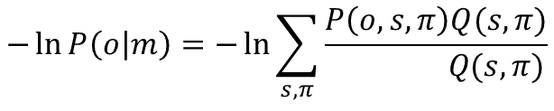

Variational Inference – Bounding evidence
$$Q\left(s\right)=\prod_{i}{Q(s_{i})}$$
$$Q\left(s\right)=\prod_{i}{Q(s_{i})}$$
Consider the approximate posterior distribution:
Rewriting the negative log evidence (surprise), we extract the VFE formulation:
Mean-Field approximation
$$−\ln{P\left(o | m\right)=−\ln{\sum_{s,π}{\frac{P\left(o,s,π\right)Q(s,π)}{ Q(s,π)}}}}$$
Multiply by $\frac{Q(s,π)}{Q(s,π)}$

Slide 12
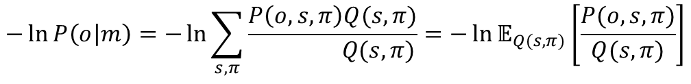
Variational Inference – Bounding evidence
$$Q\left(s\right)=\prod_{i}{Q(s_{i})}$$
$$Q\left(s\right)=\prod_{i}{Q(s_{i})}$$
Consider the approximate posterior distribution:
Rewriting the negative log evidence (surprise), we extract the VFE formulation:
Mean-Field approximation
$$−\ln{P\left(o | m\right)=−\ln{\sum_{s,π}{\frac{P\left(o,s,π\right)Q(s,π)}{ Q(s,π)}=−\ln{𝔼_{Q(s,π)}\left[\frac{P(o,s,π)}{Q(s,π)}\right]}}}}$$
Write as expectation

Slide 13
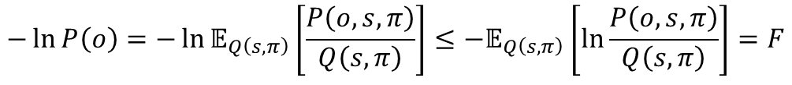
Variational Inference – Bounding evidence
$$Q\left(s\right)=\prod_{i}{Q(s_{i})}$$
$$Q\left(s\right)=\prod_{i}{Q(s_{i})}$$
Consider the approximate posterior distribution:
Rewriting the negative log evidence (surprise), we extract the VFE formulation:
Mean-Field approximation
$$−\ln{P\left(o | m\right)=−\ln{\sum_{s,π}{\frac{P\left(o,s,π\right)Q(s,π)}{ Q(s,π)}=−\ln{𝔼_{Q(s,π)}\left[\frac{P(o,s,π)}{Q(s,π)}\right]}}}}$$
Write as expectation
$$−\ln{P\left(o\right)=−\ln{𝔼_{Q\left(s,π\right)}\left[\frac{P\left(o,s,π\right)}{Q\left(s,π\right)}\right]≤−𝔼_{Q\left(s,π\right)}\left[\ln{\frac{P\left(o,s,π\right)}{Q\left(s,π\right)}}\right]}=F}$$
Via Jensen’s Inequality

Slide 14

Variational Inference – Bounding evidence
$$Q\left(s\right)=\prod_{i}{Q(s_{i})}$$
$$Q\left(s\right)=\prod_{i}{Q(s_{i})}$$
Consider the approximate posterior distribution:
Rewriting the negative log evidence (surprise), we extract the VFE formulation:
Mean-Field approximation
$$−\ln{P\left(o | m\right)=−\ln{\sum_{s,π}{\frac{P\left(o,s,π\right)Q(s,π)}{ Q(s,π)}=−\ln{𝔼_{Q(s,π)}\left[\frac{P(o,s,π)}{Q(s,π)}\right]}}}}$$
Write as expectation
$$−\ln{P\left(o\right)=−\ln{𝔼_{Q\left(s,π\right)}\left[\frac{P\left(o,s,π\right)}{Q\left(s,π\right)}\right]≤−𝔼_{Q\left(s,π\right)}\left[\ln{\frac{P\left(o,s,π\right)}{Q\left(s,π\right)}}\right]}=F}$$
Via Jensen’s Inequality
$$−\ln{P\left(o\right)}≤F$$

Slide 15





Variational Inference - Perception
$$F= \ln{P\left(O_{t}\right)−D_{KL}\left[Q\left(t\right)||P(s_{t}|o_{t})\right]}$$
Free energy
The problem of Bayesian inference becomes a problem of optimization: the minimization of variational free energy which corresponds to the maximization of model evidence.
$$o_{t}$$
$$Q(s_{t})$$
Action
Perception
$$Q\left(π\right)=σ\left(\sum_{ρ<t}{F(π},ρ)+ \sum_{τ>t}{G(π,τ)}\right)$$
$$Q\left(s_{t}\right)=arg \max_{Q}{F}$$

Slide 16
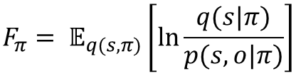
Variational Free Energy
In AcI we compute VFE wrt each policy. Beacuase observations provide evidence for policies, both approx posterior and the generative model are conditioned on policies.
$$F_{π}= 𝔼_{q(s,π)}\left[\ln{\frac{q(s|π)}{p(s,o|π)}}\right]$$

Slide 17

Variational Free Energy
In AcI we compute VFE wrt each policy. Beacuase observations provide evidence for policies, both approx posterior and the generative model are conditioned on policies.
$$F_{π}= 𝔼_{q(s,π)}\left[\ln{\frac{q(s|π)}{p(s,o|π)}}\right]$$
Expected difference between the approximate posterior and the generative model
$$= 𝔼_{q(s|π)}\left[\ln{q\left(s | π\right)− \ln{p(s,o|π)}}\right]$$

Slide 18

Variational Free Energy
In AcI we compute VFE wrt each policy. Beacuase observations provide evidence for policies, both approx posterior and the generative model are conditioned on policies.
$$F_{π}= 𝔼_{q(s,π)}\left[\ln{\frac{q(s|π)}{p(s,o|π)}}\right]$$
Expected difference between the approximate posterior and the generative model
$$= 𝔼_{q(s|π)}\left[\ln{q\left(s | π\right)− \ln{p(s,o|π)}}\right]$$
$$= 𝔼_{q(s|π)}\left[\ln{q\left(s | π\right)− \ln{p(s|π)}}\right]−𝔼_{q(s|π)}\left[\ln{p(o|s,π)}\right]$$
Product rule

Slide 19

Variational Free Energy
In AcI we compute VFE wrt each policy. Beacuase observations provide evidence for policies, both approx posterior and the generative model are conditioned on policies.
$$F_{π}= 𝔼_{q(s,π)}\left[\ln{\frac{q(s|π)}{p(s,o|π)}}\right]$$
Expected difference between the approximate posterior and the generative model
$$= 𝔼_{q(s|π)}\left[\ln{q\left(s | π\right)− \ln{p(s,o|π)}}\right]$$
$$= 𝔼_{q(s|π)}\left[\ln{q\left(s | π\right)− \ln{p(s|π)}}\right]−𝔼_{q(s|π)}\left[\ln{p(o|s,π)}\right]$$
Product rule
$$= D_{KL}\left[q\left(s | π\right)||p(s|π)\right]−𝔼_{q(s|π)}\left[\ln{p(o|s,π)}\right]$$
Complexity vs accuracy
complexity
accuracy
Notes:
Complexity => will be larger if one needs to make larger revisions to one’s beliefs. A greater complexity means there is a greater chance of changing beliefs to explain random aspects of one’s observation.
Accuracy => predictive accuracy, the probability of observations given model beliefs about states

Slide 20
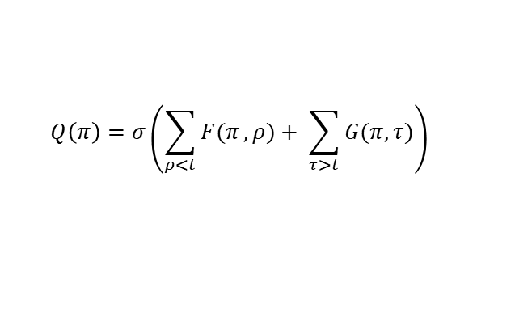




Policy
AcI is not solely concerned with minimizing prediction error in perception, but it is a model of action selection. To infer optimal actions as a model, must predict sequences of future states and observations, and then calculate the expected free energy associated with those different sequences of future states and observations.
$$F= \ln{P\left(O_{t}\right)−D_{KL}\left[Q\left(t\right)||P(s_{t}|o_{t})\right]}$$
Free energy
$$o_{t}$$
$$Q(s_{t})$$
Action
Perception
$$Q\left(π\right)=σ\left(\sum_{ρ<t}{F(π},ρ)+ \sum_{τ>t}{G(π,τ)}\right)$$
$$Q\left(s_{t}\right)=arg \max_{Q}{F}$$
Notes:
Prima la policy poi la prior

Slide 21
Policy
In Active Inference a policy is a sequence of actions:
$$π=\left\{U_{t},…,U_{T−1}\right\} where U_{τ}∈\left\{1,…,\left|U\right|\right\} ∀τ∈\left\{t,…,T−1\right\}$$
Notes:
Prima la policy poi la prior

Slide 22

Policy
In Active Inference a policy is a sequence of actions:
To define the goodness of a policy we must express the preferences of the agent wrt the observations, thus, those observations that the agent wants to reach in time:
$$π=\left\{U_{t},…,U_{T−1}\right\} where U_{τ}∈\left\{1,…,\left|U\right|\right\} ∀τ∈\left\{t,…,T−1\right\}$$
$$P(o|C)$$
Notes:
Scrivere meglio la prior così è un po’ triste buttata li’

Slide 23

Expected Free Energy - EFE
$$G_{π}= 𝔼_{q(o,s|π)}\left[\ln{q\left(s | π\right)−\ln{p(o,s|π)}}\right]$$

Slide 24
Expected Free Energy - EFE
$$G_{π}= 𝔼_{q(o,s|π)}\left[\ln{q\left(s | π\right)−\ln{p(o,s|π)}}\right]$$
Expand via product rule
$$= 𝔼_{q(o,s|π)}\left[\ln{q\left(s | π\right)−\ln{p(s|o,π)}}\right]−𝔼_{q(o|π)}\left[\ln{p(o|π)}\right]$$
Observation are now RV!

Slide 25
Expected Free Energy - EFE
$$G_{π}= 𝔼_{q(o,s|π)}\left[\ln{q\left(s | π\right)−\ln{p(o,s|π)}}\right]$$
Expand via product rule
$$= 𝔼_{q(o,s|π)}\left[\ln{q\left(s | π\right)−\ln{p(s|o,π)}}\right]−𝔼_{q(o|π)}\left[\ln{p(o|π)}\right]$$
Observation are now RV!
$$≈ 𝔼_{q(o,s|π)}\left[\ln{q\left(s | π\right)−\ln{q(s|o,π)}}\right]−𝔼_{q(o|π)}\left[\ln{p(o|C)}\right]$$
Notes:
We can drop the condition on policy because the agent’s preferences can be independent of the policy being followed

Slide 26
Expected Free Energy - EFE
$$G_{π}= 𝔼_{q(o,s|π)}\left[\ln{q\left(s | π\right)−\ln{p(o,s|π)}}\right]$$
Expand via product rule
$$= 𝔼_{q(o,s|π)}\left[\ln{q\left(s | π\right)−\ln{p(s|o,π)}}\right]−𝔼_{q(o|π)}\left[\ln{p(o|π)}\right]$$
Observation are now RV!
$$≈ 𝔼_{q(o,s|π)}\left[\ln{q\left(s | π\right)−\ln{q(s|o,π)}}\right]−𝔼_{q(o|π)}\left[\ln{p(o|C)}\right]$$
$$=−𝔼_{q(o,s|π)}\left[\ln{q\left(s | o,π\right)−\ln{q(s|π)}}\right]−𝔼_{q(o|π)}\left[\ln{p(o|C)}\right]$$
Rearranging the signs
Notes:
On the left: EPISTEMIC VALUE => information gain
On th eright: PRAGMATIC VALUE => search for policy that encounter preferred observations
The agent is driven to seek out observations that reduce uncertainty about hidden states, as it would be unclear how to bring about preferred outcome before the states are still uncertain

Slide 27
Expected Free Energy - EFE
$$G_{π}= 𝔼_{q(o,s|π)}\left[\ln{q\left(s | π\right)−\ln{p(o,s|π)}}\right]$$
Expand via product rule
$$= 𝔼_{q(o,s|π)}\left[\ln{q\left(s | π\right)−\ln{p(s|o,π)}}\right]−𝔼_{q(o|π)}\left[\ln{p(o|π)}\right]$$
Observation are now RV!
$$≈ 𝔼_{q(o,s|π)}\left[\ln{q\left(s | π\right)−\ln{q(s|o,π)}}\right]−𝔼_{q(o|π)}\left[\ln{p(o|C)}\right]$$
$$=−𝔼_{q(o,s|π)}\left[\ln{q\left(s | o,π\right)−\ln{q(s|π)}}\right]−𝔼_{q(o|π)}\left[\ln{p(o|C)}\right]$$
Rearranging the signs
Another common way to express the EFE:
$$G_{π}=D_{KL}\left[q\left(o | π\right)||p(o|C)\right]+𝔼_{q(s|π)}\left[H\left[p(o|s)\right]\right]$$
risk
ambiguity
Notes:
RISK => probability of reward for each choice one could make
AMBIGUITY => policies that minimize ambiguity will try to occupy states that are expected to generate the most informative observations, that will reduce uncertainty
Note that the EFE is expressed wrt to each policy, we here first see the main problem: CONSIDER EVERY POLICY AS A POSSIBLE ONE
Minimizing EFE wiil drive selection of the policies that maximizes both reward and information gain

Slide 28
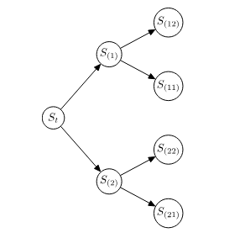
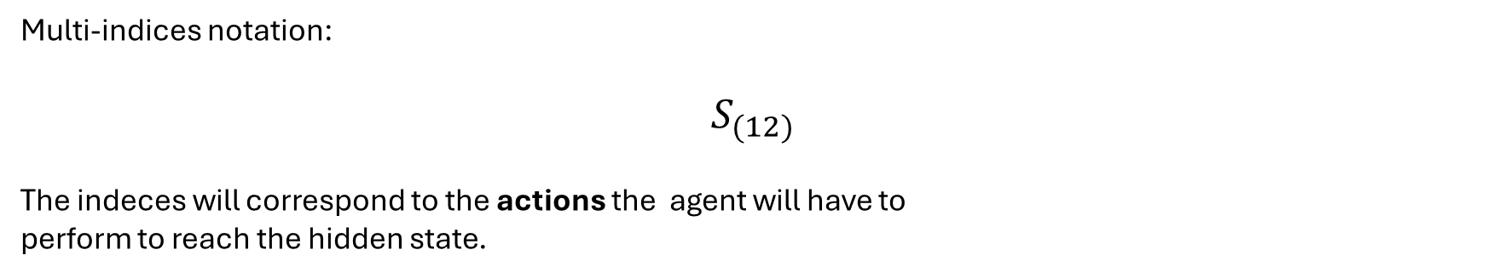
The problem: Exponential complexity class
Multi-indices notation:
$$S_{(12)}$$
The indeces will correspond to the actions the agent will have to
perform to reach the hidden state.
2
1
1
2
Notes:
Come detto prima la efe va calcolata per ogni policy definita su un orizzonte temporale

Slide 29
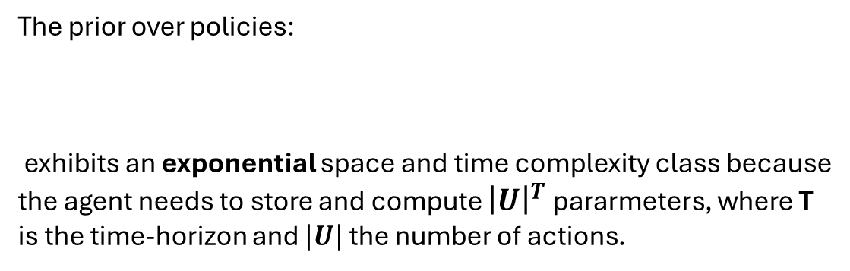

The problem: Exponential complexity class
Multi-indices notation:
$$S_{(12)}$$
The indeces will correspond to the actions the agent will have to
perform to reach the hidden state.
2
1
1
The prior over policies:
exhibits an exponential space and time complexity class because the agent needs to store and compute ${\left|U\right|}^{T}$ pararmeters, where T is the time-horizon and $\left|U\right|$the number of actions.
2
$$P\left(π | γ\right)=σ(−γG)$$
Notes:
The before seen problem can then be handle by reducing firstly the number of policies the agent consider and then pursuing only those that the agent consider rewarding, this is achieved by….MCTS

Slide 30
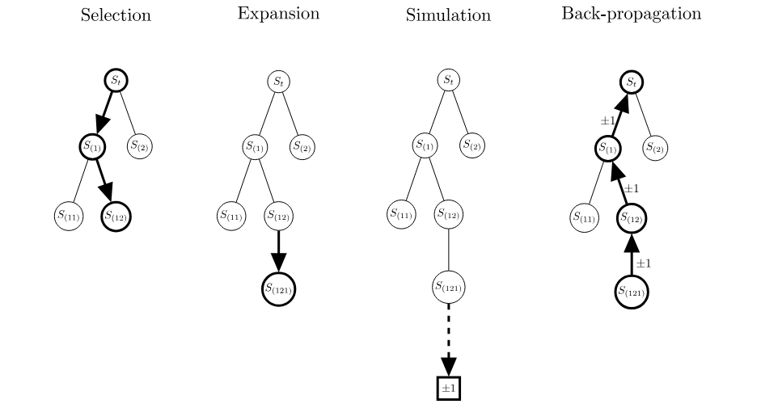
Monte Carlo Tree Search - MCTS
Notes:
The algorithm essentialy builds a tree in which each node corresponds to a FUTURE state and each egde represents the action that led to that state => explore only a subset of the policies, in articular those that the agent consider best to follow.
Initially only the root state is considered and the process follows these 4 steps iteratively according to the maximum planning iteration, that sortly overtake the time horizon, THEREFORE THE HORIZON IS CHANGED WITH A SIMULATION HORIZON

Slide 31
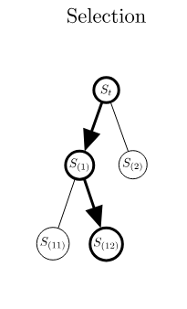


MCTS - Selection
The selection process starts at the root node, if the root node still has unexplored children, then one of them is selected. Otherwise, the child node maximizing the UCT criterion is selected to be the new root in the next iteration
${\overline{g}}_{j}=cost of the j^{th} child of the roo$
$${ C}_{p}=exploration constant$$
$n=number of the {parent}^{′}s visits$
$n_{j}=number of {node j}^{th}$
$${UCT}_{j}= {−\overline{g}}_{j}+2C_{p}\sqrt{\frac{2\ln{n}}{n_{j}}}$$
exploitation
exploration

Slide 32
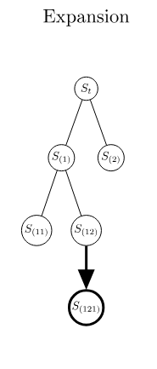

MCTS - Expansion
Expand all possible actions from the selected node $S_{I\backslash last}$
For each action, we expand the generative model by adding a (expected) future hidden state whose prior distribution is given by:
$$P\left(S_{I} | S_{I\backslash last}\right)=Cat({\overline{B}}_{I})$$

Slide 33


MCTS - Expansion
Expand all possible actions from the selected node $S_{I\backslash last}$
For each action, we expand the generative model by adding a (expected) future hidden state whose prior distribution is given by:
$$P\left(S_{I} | S_{I\backslash last}\right)=Cat({\overline{B}}_{I})$$
We expand the (future) observation associated with the new hidden state $S:$
$$P\left(O_{I} | S_{I}\right)=Cat({\overline{A}}_{I})$$
$$O_{I}$$

Slide 34
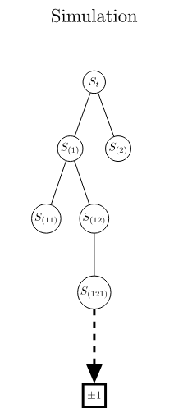


MCTS - Evaluation
Compute the cost of the newly expanded nodes, respectively of their simulated future.
$$Q\left(O_{I}\right)=observation posterior$$
$V\left(O_{I}\right)=observation prior$
$$P\left(O_{I} | S_{I}\right)=likelihood mapping$$
$$g_{I}^{classic}≜D_{KL}\left[Q\left(O_{I}\right)||V\left(O_{I}\right)\right]+ 𝔼_{Q\left(S_{I}\right)}\left[H\left[P\left(O_{I}|S_{I}\right)\right]\right]$$
risk
ambiguity
$$g_{I}^{classic}$$
The cost will influece the probability of being selected during future iterations.

Slide 35
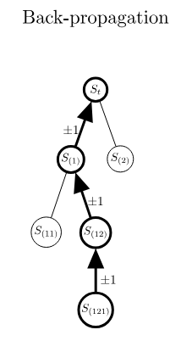

MCTS - Propagation
The cost of the newly expanded nodes is propagated backwards to the root.
$$G_{j}^{aggr}= G_{j}^{aggr}+g_{I} ∀ j ∈ 𝔸_{I}$$

Slide 36
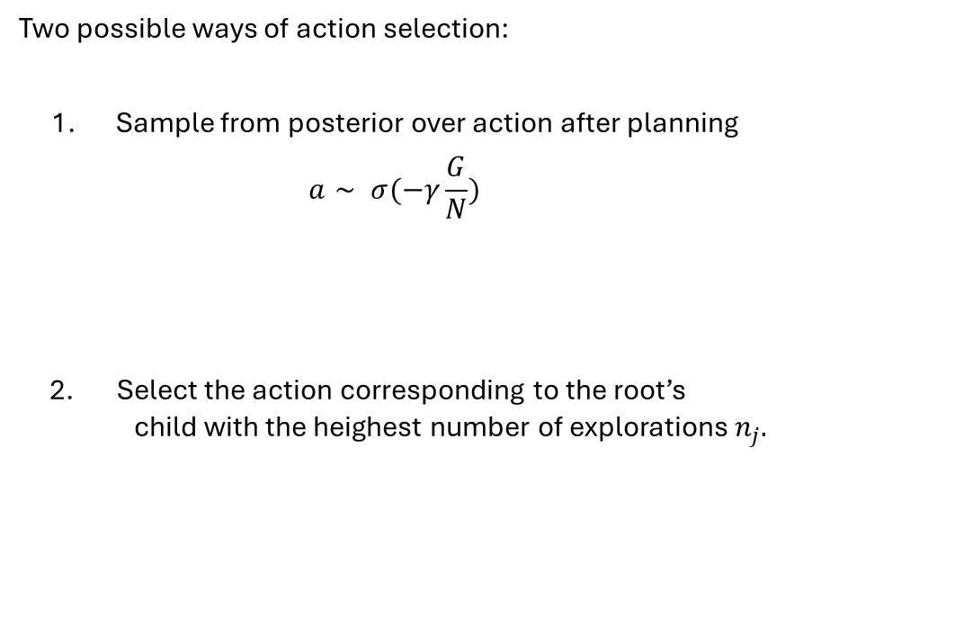


MCTS - Action Selection
Two possible ways of action selection:
Sample from posterior over action after planning
$$a∼ σ(−γ\frac{G}{N})$$
2. Select the action corresponding to the root’s child with the heighest number of explorations $n_{j}.$
$$G:children^{′}s cost$$
$$N:children^{′}s visits$$

Slide 37
Action-perception cycle with tree search
while end of trial not reached do
sample an observation from the environment
perform inference using the observation
while maximum planning iteration not reached do
select a node to be expanded
perform inference on the newly expanded nodes
evaluate the cost of the newly expanded nodes
propagate the cost of the nodes through the tree backward
end
select an action to be performed
execute the action in the environment
end

Slide 38
Implementation - Outline
Pymdp suite
MCTS class
Node class
Btai_agent class

Slide 39

PYMDP - Agent
agent = Agent(A, B, C, D)
Agent

Slide 40

PYMDP - Agent
agent = Agent(A, B, C, D)
$$P(o_{t}|s_{t},A)$$
Likelihood mapping
Agent

Slide 41

PYMDP - Agent
agent = Agent(A, B, C, D)
$$P(s_{t+1}|s_{t},u_{t},B)$$
$$P(o_{t}|s_{t},A)$$
Transition matrix
Likelihood mapping
Agent

Slide 42

PYMDP - Agent
agent = Agent(A, B, C, D)
$$P(o|C)$$
$$P(s_{t+1}|s_{t},u_{t},B)$$
$$P(o_{t}|s_{t},A)$$
Observation prior
Transition matrix
Likelihood mapping
Agent

Slide 43

PYMDP - Agent
agent = Agent(A, B, C, D)
$$P\left(S_{0} | D\right)$$
$$P(o|C)$$
$$P(s_{t+1}|s_{t},u_{t},B)$$
$$P(o_{t}|s_{t},A)$$
Initial state prior
Observation prior
Transition matrix
Likelihood mapping
Agent

Slide 44

PYMDP – Action Percpetion Cycle
obs
qs = agent.infer_states(obs)
q_pi, G = my_agent.infer_policies()
obs = env.step(action)
Agent
Environment
action = Agent.sample_action()

Slide 45
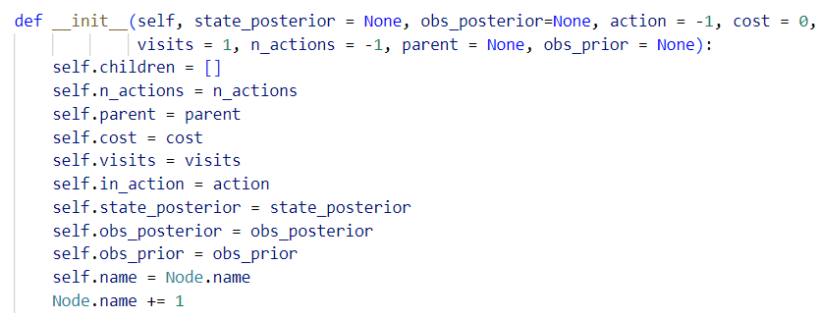
Node class - Attributes
n.parent
n.in_action
n
n.cost
n.visits
n.children

Slide 46
Node class - Attributes
n.parent
n.in_action
n
n.cost
n.visits
defined during expansion
n.children

Slide 47

Node class - Methods
n.parent
Methods:
uct: ${ UCT}_{j}= {−\overline{g}}_{j}+2C_{p}\sqrt{\frac{2\ln{n}}{n_{j}}}$
predictive_step: $P\left(S_{I} | S_{I\backslash last}\right)$, $P\left(O_{I} | S_{I}\right)$
efe: $g_{I}^{classic}≜D_{KL}\left[Q\left(O_{I}\right)||V\left(O_{I}\right)\right]+ 𝔼_{Q\left(S_{I}\right)}\left[H\left[P\left(O_{I}|S_{I}\right)\right]\right]$
n.in_action
n
n.cost
n.visits

Slide 48
Node class - Methods
n.parent
Methods:
uct: ${ UCT}_{j}= {−\overline{g}}_{j}+2C_{p}\sqrt{\frac{2\ln{n}}{n_{j}}}$
predictive_step: $P\left(S_{I} | S_{I\backslash last}\right)$, $P\left(O_{I} | S_{I}\right)$
efe: $g_{I}^{classic}≜D_{KL}\left[Q\left(O_{I}\right)||V\left(O_{I}\right)\right]+ 𝔼_{Q\left(S_{I}\right)}\left[H\left[P\left(O_{I}|S_{I}\right)\right]\right]$
n.in_action
n
n.cost
n.visits

Slide 49
Node class - Methods
n.parent
Methods:
uct: ${ UCT}_{j}= {−\overline{g}}_{j}+2C_{p}\sqrt{\frac{2\ln{n}}{n_{j}}}$
predictive_step: $P\left(S_{I} | S_{I\backslash last}\right)$, $P\left(O_{I} | S_{I}\right)$
efe: $g_{I}^{classic}≜D_{KL}\left[Q\left(O_{I}\right)||V\left(O_{I}\right)\right]+ 𝔼_{Q\left(S_{I}\right)}\left[H\left[P\left(O_{I}|S_{I}\right)\right]\right]$
n.in_action
n
n.cost
n.visits

Slide 50

Node class - Methods
n.parent
Methods:
uct: ${ UCT}_{j}= {−\overline{g}}_{j}+2C_{p}\sqrt{\frac{2\ln{n}}{n_{j}}}$
predictive_step:
efe: $g_{I}^{classic}≜D_{KL}\left[Q\left(O_{I}\right)||V\left(O_{I}\right)\right]+ 𝔼_{Q\left(S_{I}\right)}\left[H\left[P\left(O_{I}|S_{I}\right)\right]\right]$
n.in_action
n
n.cost
n.visits

Slide 51

Node class - Methods
n.parent
Methods:
uct: ${ UCT}_{j}= {−\overline{g}}_{j}+2C_{p}\sqrt{\frac{2\ln{n}}{n_{j}}}$
predictive_step: $P\left(S_{I} | S_{I\backslash last}\right)$
efe: $g_{I}^{classic}≜D_{KL}\left[Q\left(O_{I}\right)||V\left(O_{I}\right)\right]+ 𝔼_{Q\left(S_{I}\right)}\left[H\left[P\left(O_{I}|S_{I}\right)\right]\right]$
n.in_action
n
n.cost
n.visits

Slide 52

Node class - Methods
n.parent
Methods:
uct: ${ UCT}_{j}= {−\overline{g}}_{j}+2C_{p}\sqrt{\frac{2\ln{n}}{n_{j}}}$
predictive_step: $P\left(S_{I} | S_{I\backslash last}\right)$
efe: $g_{I}^{classic}≜D_{KL}\left[Q\left(O_{I}\right)||V\left(O_{I}\right)\right]+ 𝔼_{Q\left(S_{I}\right)}\left[H\left[P\left(O_{I}|S_{I}\right)\right]\right]$
n.in_action
n
n.cost
n.visits
$$P\left(S_{I} | S_{I\backslash last}\right)$$
expected_state

Slide 53

Node class - Methods
n.parent
Methods:
uct: ${ UCT}_{j}= {−\overline{g}}_{j}+2C_{p}\sqrt{\frac{2\ln{n}}{n_{j}}}$
predictive_step: $P\left(S_{I} | S_{I\backslash last}\right)$, $P\left(O_{I} | S_{I}\right)$
efe: $g_{I}^{classic}≜D_{KL}\left[Q\left(O_{I}\right)||V\left(O_{I}\right)\right]+ 𝔼_{Q\left(S_{I}\right)}\left[H\left[P\left(O_{I}|S_{I}\right)\right]\right]$
n.in_action
n
n.cost
n.visits
$$P\left(S_{I} | S_{I\backslash last}\right)$$
$$P\left(O_{I} | S_{I}\right)$$
expected_state
expected_obs

Slide 54
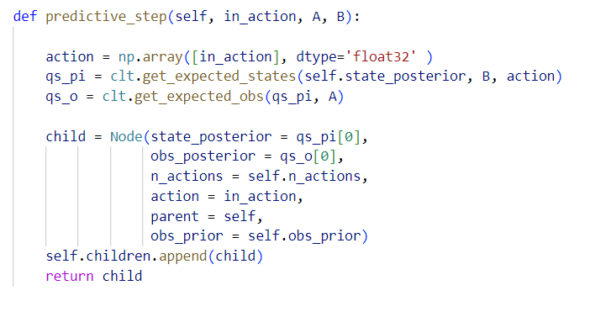

Node class - Methods
Methods:
predictive_step: $P\left(S_{I} | S_{I\backslash last}\right)$, $P\left(O_{I} | S_{I}\right)$
n.parent
n.in_action
n
n.cost
n.visits
$$P\left(S_{I} | S_{I\backslash last}\right)$$
$$P\left(O_{I} | S_{I}\right)$$
expected_state
expected_obs

Slide 55

Node class - Methods
n.parent
Methods:
uct: ${ UCT}_{j}= {−\overline{g}}_{j}+2C_{p}\sqrt{\frac{2\ln{n}}{n_{j}}}$
predictive_step: $P\left(S_{I} | S_{I\backslash last}\right)$, $P\left(O_{I} | S_{I}\right)$
efe:
n.in_action
n
n.cost
n.visits
$$P\left(S_{I} | S_{I\backslash last}\right)$$
$$P\left(O_{I} | S_{I}\right)$$
expected_state
expected_obs

Slide 56
Node class - Methods
n.parent
Methods:
uct: ${ UCT}_{j}= {−\overline{g}}_{j}+2C_{p}\sqrt{\frac{2\ln{n}}{n_{j}}}$
predictive_step: $P\left(S_{I} | S_{I\backslash last}\right)$, $P\left(O_{I} | S_{I}\right)$
efe:
n.in_action
n
n.cost
n.visits
$$P\left(S_{I} | S_{I\backslash last}\right)$$
$$P\left(O_{I} | S_{I}\right)$$
expected_state
expected_obs

Slide 57
Node class - Methods
n.parent
Methods:
uct: ${ UCT}_{j}= {−\overline{g}}_{j}+2C_{p}\sqrt{\frac{2\ln{n}}{n_{j}}}$
predictive_step: $P\left(S_{I} | S_{I\backslash last}\right)$, $P\left(O_{I} | S_{I}\right)$
efe: $g_{I}^{classic}≜D_{KL}\left[Q\left(O_{I}\right)||V\left(O_{I}\right)\right]+ 𝔼_{Q\left(S_{I}\right)}\left[H\left[P\left(O_{I}|S_{I}\right)\right]\right]$
n.in_action
n
n.cost
n.visits
$$P\left(S_{I} | S_{I\backslash last}\right)$$
$$P\left(O_{I} | S_{I}\right)$$
expected_state
expected_obs

Slide 58
Node class - Methods
n.parent
Methods:
uct: ${ UCT}_{j}= {−\overline{g}}_{j}+2C_{p}\sqrt{\frac{2\ln{n}}{n_{j}}}$
predictive_step: $P\left(S_{I} | S_{I\backslash last}\right)$, $P\left(O_{I} | S_{I}\right)$
efe: $g_{I}^{classic}≜D_{KL}\left[Q\left(O_{I}\right)||V\left(O_{I}\right)\right]+ 𝔼_{Q\left(S_{I}\right)}\left[H\left[P\left(O_{I}|S_{I}\right)\right]\right]$
n.in_action
n
n.cost
n.visits
$$P\left(S_{I} | S_{I\backslash last}\right)$$
$$P\left(O_{I} | S_{I}\right)$$
expected_state
expected_obs

Slide 59
Node class - Methods
n.parent
Methods:
uct: ${ UCT}_{j}= {−\overline{g}}_{j}+2C_{p}\sqrt{\frac{2\ln{n}}{n_{j}}}$
predictive_step: $P\left(S_{I} | S_{I\backslash last}\right)$, $P\left(O_{I} | S_{I}\right)$
efe: $g_{I}^{classic}≜D_{KL}\left[Q\left(O_{I}\right)||V\left(O_{I}\right)\right]+ 𝔼_{Q\left(S_{I}\right)}\left[H\left[P\left(O_{I}|S_{I}\right)\right]\right]$
n.in_action
n
n.cost
n.visits
$$P\left(S_{I} | S_{I\backslash last}\right)$$
$$P\left(O_{I} | S_{I}\right)$$
expected_state
expected_obs

Slide 60
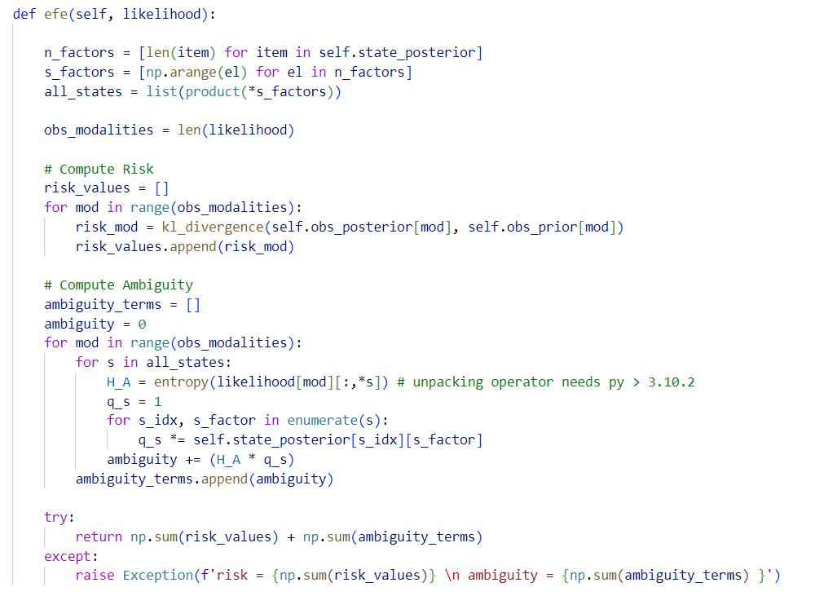

Node class - Methods
Methods:
efe: $g_{I}^{classic}≜D_{KL}\left[Q\left(O_{I}\right)||V\left(O_{I}\right)\right]+ 𝔼_{Q\left(S_{I}\right)}\left[H\left[P\left(O_{I}|S_{I}\right)\right]\right]$
n.parent
n.in_action
n
n.cost
n.visits
$$P\left(S_{I} | S_{I\backslash last}\right)$$
$$P\left(O_{I} | S_{I}\right)$$
expected_state
expected_obs

Slide 61
Node class - Methods
Methods:
efe: $g_{I}^{classic}≜D_{KL}\left[Q\left(O_{I}\right)||V\left(O_{I}\right)\right]+ 𝔼_{Q\left(S_{I}\right)}\left[H\left[P\left(O_{I}|S_{I}\right)\right]\right]$
n.parent
n.in_action
n
n.cost
n.visits
$$P\left(S_{I} | S_{I\backslash last}\right)$$
$$P\left(O_{I} | S_{I}\right)$$
expected_state
expected_obs

Slide 62
Node class - Methods
Methods:
efe: $g_{I}^{classic}≜D_{KL}\left[Q\left(O_{I}\right)||V\left(O_{I}\right)\right]+ 𝔼_{Q\left(S_{I}\right)}\left[H\left[P\left(O_{I}|S_{I}\right)\right]\right]$
n.parent
n.in_action
n
n.cost
n.visits
$$P\left(S_{I} | S_{I\backslash last}\right)$$
$$P\left(O_{I} | S_{I}\right)$$
expected_state
expected_obs

Slide 63
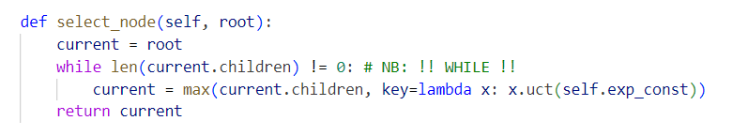
MCTS class

Slide 64
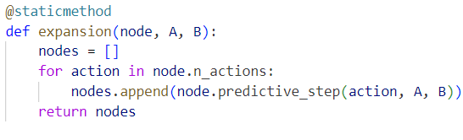
MCTS class

Slide 65
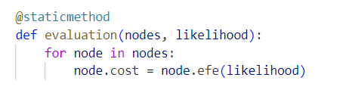
MCTS class

Slide 66
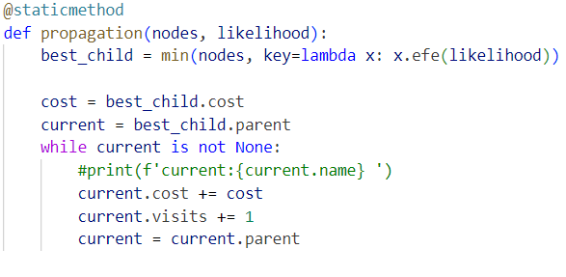
MCTS class

Slide 67

BTAI_agent
agent = BTAI_agent(MCTS(),
max_planning_iteration, gamma,
action_selection,
**agent_info)
$$P\left(S_{0} | D\right)$$
$$P(o|C)$$
$$P(s_{t+1}|s_{t},u_{t},B)$$
$$P(o_{t}|s_{t},A)$$
BTAI_agent

Slide 68
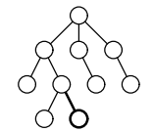
BTAI_agent
agent = BTAI_agent(MCTS(),
max_planning_iteration, gamma,
action_selection,
**agent_info)
$$P\left(S_{0} | D\right)$$
$$P(o|C)$$
$$P(s_{t+1}|s_{t},u_{t},B)$$
$$P(o_{t}|s_{t},A)$$
MCTS
BTAI_agent

Slide 69
BTAI_agent
agent = BTAI_agent(MCTS(),
max_planning_iteration, gamma,
action_selection,
**agent_info)
$$P\left(S_{0} | D\right)$$
$$P(o|C)$$
$$P(s_{t+1}|s_{t},u_{t},B)$$
$$P(o_{t}|s_{t},A)$$
MCTS
BTAI_agent

Slide 70
BTAI_agent
agent = BTAI_agent(MCTS(),
max_planning_iteration, gamma,
action_selection,
**agent_info)
$$P\left(S_{0} | D\right)$$
$$P(o|C)$$
$$P(s_{t+1}|s_{t},u_{t},B)$$
$$P(o_{t}|s_{t},A)$$
MCTS
sample_action
‘’SAMPLE’’ or ‘’MOST_VISITS’’
BTAI_agent

Slide 71
BTAI_agent – Action Percpetion Cycle
obs
qs = agent.infer_states(obs)
root = Node(qs, U, C)
action = BTAI_agent.step(root) //execute MCTS
for t in max_planning_iteration:
node = select_node(root)
e_nodes = expansion(node)
evaluation(e_nodes, A)
propagation(e_nodes, A)
obs = env.step(action)
BTAI_agent
Environment
action

Slide 72
References
Ryan Smith, Karl J. Friston, Christopher J. Whyte, A step-by-step tutorial on active inference and its application to empirical data, 2022, https://doi.org/10.1016/j.jmp.2021.102632
Théophile Champion, Howard Bowman, Marek Grześ, Branching time active inference: Empirical study and complexity class analysis, 2022, https://doi.org/10.1016/j.neunet.2022.05.010
Théophile Champion, Lancelot Da Costa, Howard Bowman, Marek Grześ, Branching Time Active Inference: The theory and its generality, 2022, https://doi.org/10.1016/j.neunet.2022.03.036
Champion, Théophile & Grzes, Marek & Bowman, Howard. (2021). Branching Time Active Inference with Bayesian Filtering. https://doi.org/10.48550/arXiv.2112.07406
Heins et al., (2022). pymdp: A Python library for active inference in discrete state spaces. Journal of Open Source Software, 7(73), 4098, https://doi.org/10.21105/joss.04098
Champion, Théophile & Grzes, Marek & Bowman, Howard. (2021). Realising Active Inference in Variational Message Passing: the Outcome-blind Certainty Seeker. https://doi.org/10.48550/arXiv.2104.11798
Kirsch, L. (2018). Theories of Intelligence (2/2): Active Inference. https://louiskirsch.com/ai/active-inference

